Slide 1
Modern Control Theory
Model Predict Control - MPC – Lecture 12
Closed loop stability – SISO Unconstrained

Slide 2
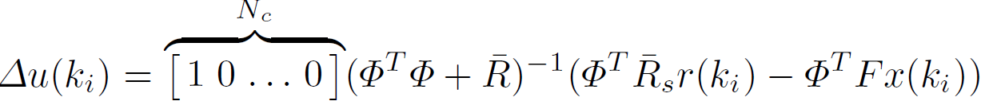

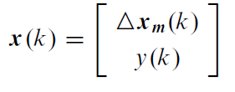


Closed loop analysis in Unconstrained MPC
Recall ΔU = (Φ^{T}Φ + R)⁻¹Φ^{T} (R_{s} – F$\hat{x}$(k_{i}))
K_{y} = First element of (Φ^{T}Φ + R)⁻¹Φ^{T} R_{s}
K_{mpc} = First element of (Φ^{T}Φ + R)⁻¹Φ^{T}F
Recall Incremental model
Closed loop Eigen Values are

Slide 3

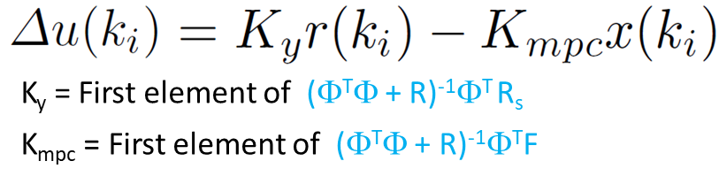






Closed loop stability example
ΔU = (Φ^{T}Φ + R)⁻¹Φ^{T} (R_{s} – F$\hat{x}$(k_{i}))
Case 1: No constraint on U R= 0
Δu = [7.2 -6.4 0 0]
Case 1: Eigen Values
λ1 = 0.8297 * 10⁻⁷
λ2 = -0.8297 * 10⁻⁷
Case 2: constraint on U R= 10
Δu = [0.127 0.103 0.083 0.07]
System has become slower
Case 2: Eigen Values

